Slide 1
Graph Based Search
Name: Andy
Mentor: Tania
Notes:
Good afternoon everyone, my name is Andy and my mentor Tania. Today I will be presenting to you on my project called the Graph Based Search

Slide 2
Introduction
1

Slide 3


PROBLEM STATEMENT
HR policies for a same topic are in disparate categories
Not aware what to search
Notes:
The problem that we are facing today is that HR policies with the same topic are group under different categories and this can get very confusing and messy for our users, for example retirement consists of payout, which falls under the finance category while retirement tea ceremony falls under the welfare category. Hence, users may not be aware of what to search, resulting in not being able to find what they actually want

Slide 4

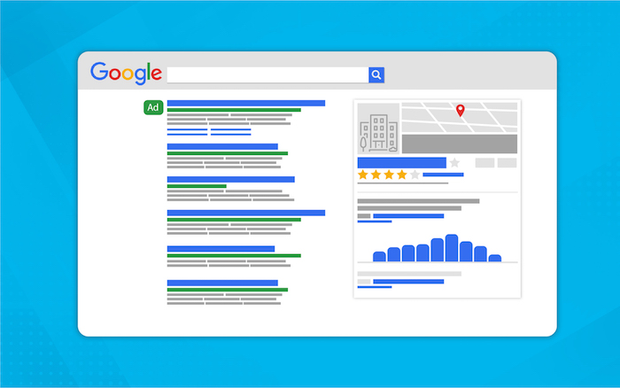

SOLUTION
Search Engine
Knowledge Panel (Related information)
Recommendation
Notes:
So, the solution to this problem is to create a search engine with a knowledge panel which contains information related to the search term. We will also make recommendations to the users based on their profile, to suggest policies that they may be interested in

Slide 5





TECH STACK
Front End
Back End
Database
Notes:
These are the technologies that I have used in my project. I used HTML, CSS, and Vue.js for the front end of my application, using python for my backend logic and retrieving data from neo4j graph database

Slide 6
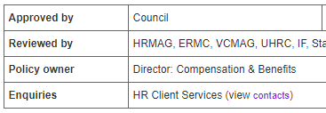

PROJECT SCOPE
HR Policy Website
Users’ search history
Scrape data
Flask Framework
Insert data
Recommend
Retrieve data
Machine learning (User-Based Collaborative Filtering)
Machine Learning (Document Clustering)
Notes:
The first step of building my application is to populate the database, I have created a spider using Scrapy to scrape data from a HR Policy website that Tania has provided me with. From the data, I will identify and extract important relationships of the policies such as policy owner. Next, I performed document clustering to find hidden relationships between the different text documents I have scraped. All these data will then be inserted into neo4j. After that I created the app, and applied user-based collaborative filtering to recommend policies to users. Lastly, there is a loop where the search history of users will be inserted back into the database for a more accurate recommendation

Slide 7
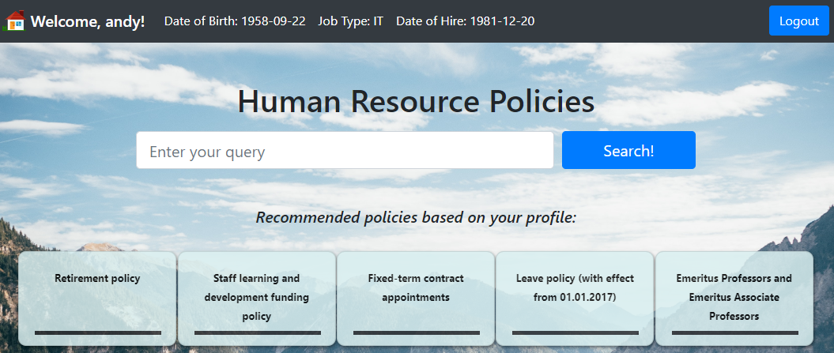
Demo
2
Notes:
For this demo, I will assume a persona of a soon to be retiree, who is from the IT department. What is shown here is a personalized search page for me. In the middle, there is a search bar and below it are some recommended policies based on my profile. As I am retiring soon, the retirement policy is recommended to me. So now if I were to click into the policy, the search results will be shown on the left, while a knowledge panel will be automatically generated based on the first result. If there are more search result, it will be shown below. Moving on to the knowledge panel, it contains information that are related to the search term, such as the policy owner. There is also an image shown over here which is stored as a URL path pointing to the actual image inside neo4j. Next, we can see topics related to retirement such as normal retirement, and when you click on it, it will show more details about it. Besides clicking on the recommendation, you can also make your own searches using the search bar. This search bar allows you to enter multiple terms such as leave and retire, which will show results related to both terms. Besides that you don’t have to enter the exact words, for example you can enter retire, retiring or retirement, which will all generates the same results. After searching, you can just refresh and more recommendations will be suggested to you. Underlying technology that is powering this search page is actually neo4j. Over here you can see that this user has searched for multiple policies, all these search arrow are actually relationships linking the nodes together. If you are interested in the leave policy, you can just double click it. From here you can see that there are many other users who have also searched for this policy. And these are the related terms that you saw earlier. You can also see who is the policy owner for this policy. And lets say if you want to know what other policies does he own, you can also double click it and know that he also own the retirement policy, study and exam policy

Slide 8
Program Algorithms
3

Slide 9
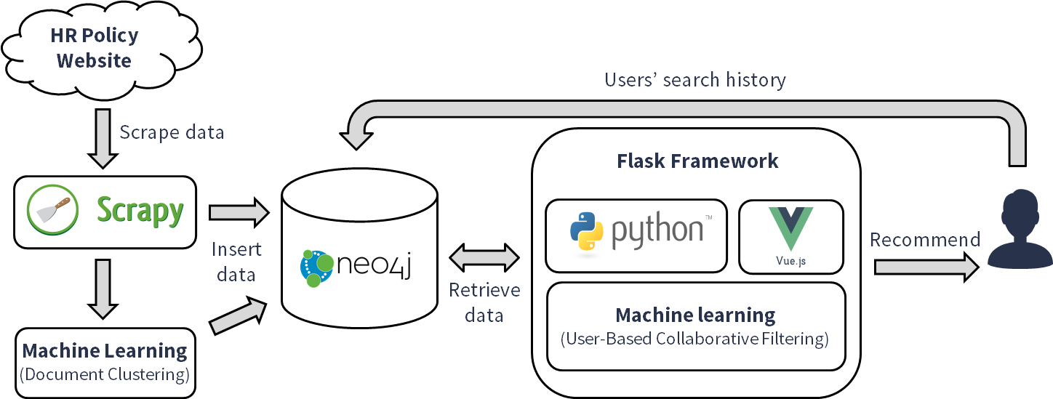
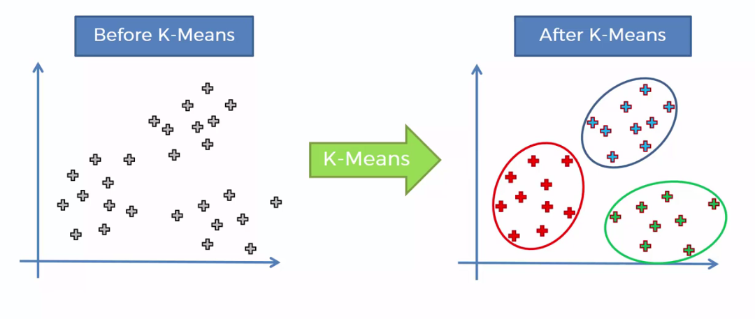
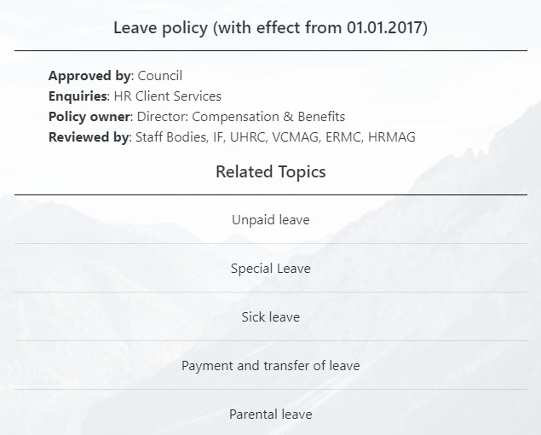
CLUSTERING
Leaves
Retirement
Outcome: Group similar content together
Notes:
As seen in the demo earlier, there is this related topics section in the knowledge panel. And it is actually created using document clustering. Here is a simple visualisation to show what clustering does, it is basically to group random points on a vector space together based on a certain similarity or attribute. After the grouping, we can then try to interpret what the clusters are. For example the blue clusters are leaves and the green clusters are retirement

Slide 10
CLUSTERING
1) Preprocessing
2) K-Means Algorithm
3) Postprocessing
Notes:
These are the 3 steps that I used to perform clustering, I will go into the steps in the next slide

Slide 11
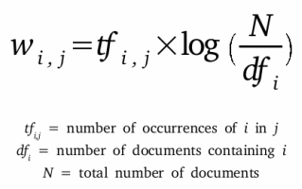
1) Preprocessing
2) K-Means Algorithm
3) Postprocessing
Tools used: NLTK and Sklearn
Preprocessing Pseudo Code:
Begin
Before: ‘This policies are interesting’
After: ‘This’, ‘policies’, ‘are’, ‘interesting’
Tokenization
Lowercase every word
Remove punctuations
Remove stopwords
Perform stemming
Remove single and double letters
TF-IDF
Before: ‘policies’, ‘interesting’
After: ‘policy’, ‘interest’
End
Notes:
For preprocessing, the first step is to perform tokenization, which is to split a sentence into a sequence of words. Next I will lower case every word, remove punctuation and stopwords. After that I performed stemming, which is to convert the words into their root form. For example, “interesting” would become interest. Next I will remove single and double letters. Lastly I will perform TF-IDF, to calculate the number of occurrence of each words and penalizing frequent words that appear in multiple documents

Slide 12
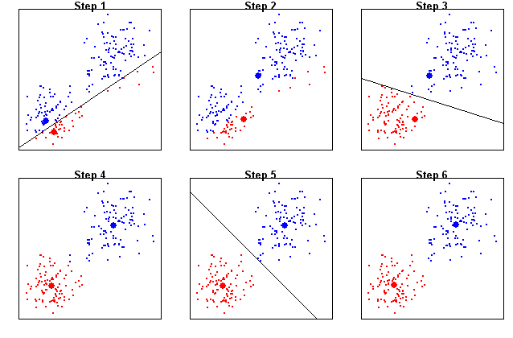
1) Preprocessing
2) K-Means Algorithm
3) Postprocessing
K-Means Pseudo Code:
Begin
Select initial cluster seeds
Assign observation to the cluster whose mean is closest based on Euclidean distance
Compute new cluster centroids
Compute SSE
Repeat 2 - 5 till very small change in SSE
End
Notes:
For the K-means algorithm, we will first have to select an initial cluster seeds and that would be the big blue and red dots in step 1. Next, we will assign the observations to the cluster whose mean is closest based on Euclidean distance. After that we will compute the new cluster centroids as we can see in step 2 where the big blue and red dots moved, and we will compute the SSE. Then we will repeat the steps assigning, computing, assigning, computing until no changes in SSE

Slide 13
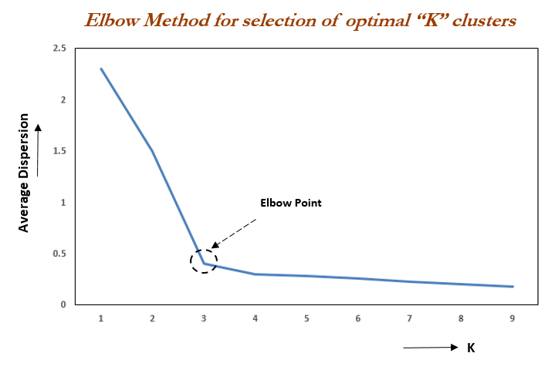
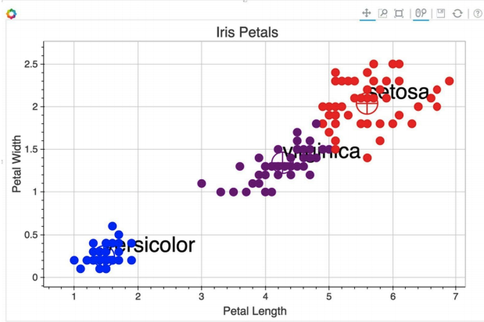
1) Preprocessing
2) K-Means Algorithm
3) Postprocessing
Find optimal k using elbow method
Visualize and interpret the clusters
Notes:
The last step of clustering is postprocessing where I will try to find the optimal k for my k-means algorithm using the elbow method. I will use a for loop from 2 to 10 to calculate the SSE and generate the graph shown here. Next I will look for an “elbow”, where SSE falls rapidly until the changes are small with increasing k. I will also visualize and interpret the clusters as machine alone will not be able to know what each clusters means

Slide 14
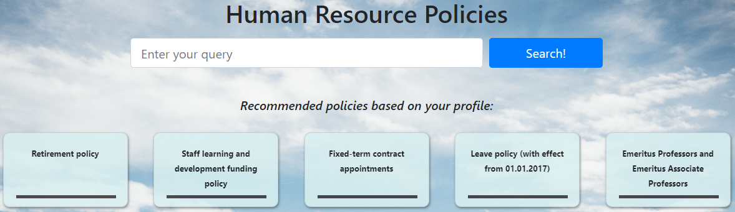
COLLABORATIVE FILTERING
Read by both users
👩
👨
Similar users
Alice
Alex
Read by Alice, but not Alex Hence, recommended to Alex
Notes:
The recommended policies you see in the demo is generated through collaborative filtering. So here is how it works for example, Alice and Alex are similar users in terms of age and department. They both read the same policies. However, Alice read this particular policy that Alex did not. Hence this policy will be recommended to Alex

Slide 15
COLLABORATIVE FILTERING
1) Preprocessing
2) Cosine Similarity
3) K-Nearest Neighbours Algorithm
Notes:
These are the 3 steps that I used to perform collaborative filtering, I will go into the steps in the next slide

Slide 16
1) Preprocessing
2) Cosine Similarity
3) K-Nearest Neighbours Algorithm
Preprocessing Pseudo Code:
Begin
Name | Job Type
User1 | IT
User2 | HR
User3 | Finance
Calculate age from date of birth
Calculate employment age from date of hire
One hot encode job types
Replace NaN values with policies search average
Name | IT | HR | Finance
User1 | 1 | 0 | 0
User2 | 0 | 1 | 0
User3 | 0 | 0 | 1
End
Notes:
For the preprocessing, I will calculate age from date of birth and employment age from date of hire. Next I will perform one hot encoding on job types because the job types are in categorical data type which cannot be used in a calculation, hence I will convert them into numbers. After that I will replace all NaN values with the policies search average

Slide 17
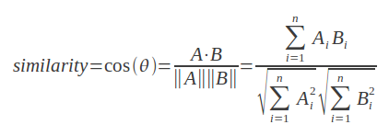


1) Preprocessing
2) Cosine Similarity
3) K-Nearest Neighbours Algorithm
Example:
Doc 1 = (0, 1, 1, 0, 0, 0)
Doc 2 = (0, 1, 1, 1, 0, 0)
Doc 3 = (0, 1, 1, 1, 1, 1)
Doc 1 & Doc 2
= 2 / (√2∗√3)
= 0.82
The closer to 1, the more similar
Thus, Doc 1 and Doc 2 is more similar
$A∙B= A_{1}B_{1}$ + $A_{2}B_{2}$+ … + $A_{N}B_{N}$
Doc 1 & Doc 3
= 2 / (√2∗√5)
= 0.63
$$\left\|A\right\|= \sqrt{A_{1}^{2}+A_{2}^{2}+…+A_{N}^{2}}$$
Notes:
On the left is the formula for cosine similarity. Which is the dot product of 2 vectors A and B, divided by the product of their norm. For example we have 3 documents, document 1, 2 and 3. We want to find out whether doc 1 is more similar to doc 2 or 3. So we apply the cosine similarity formula, where we find the dot product which is equal to 2, and then we find the norm and divide the 2 numbers to get 0.82. Similarly, we will do the same thing for doc 1 and 3, where we get 0.63. And since 0.82 is higher than 0.63, we can then say that doc 1 and doc 2 is more similar

Slide 18
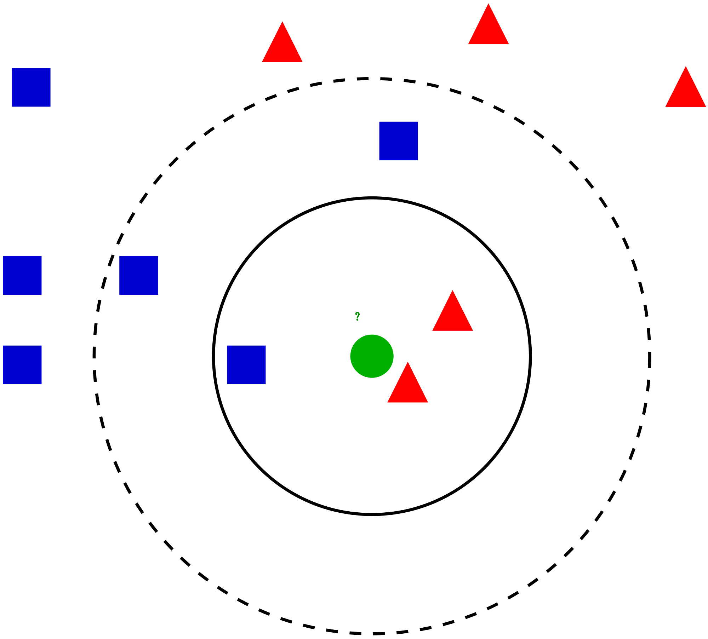
1) Preprocessing
2) Cosine Similarity
3) K-Nearest Neighbours Algorithm
K-Nearest Neighbours Pseudo Code:
Begin
Determine K, number of nearest neighbours
Calculate the distance between the query-instance and all other samples
Sort the distance and determine nearest neighbours based on the K-th minimum distance
End
Notes:
For K-nearest neighbours, firstly I will determine the K, which is the number of nearest neighbours that I intend to find. I will then calculate the distance between the query-instance and all other samples which we already did using the cosine similarity. Lastly, I will sort the distance and determine nearest neighbours based on the k minimum distance

Slide 19
MY LEARNING JOURNEY
4

Slide 20
OVERCOMING CHALLENGES
Implementing New Technology
Neo4j’s Official Python Driver
Different Approaches for Recommendation
Implement my application and research at the same time
Lots of trial and errors
Doesn’t provide much documentation
Need to research through Stack Overflow
Switched to py2neo (community driver) instead
Find out their purposes and determine if it is suitable for my application
Notes:
So there are quite a few challenges that I have faced while doing this project. Over here I will be talking more about them and how I overcome these challenges. Firstly, is implementing new technology. Because there are quite a number of new technology in this project that I wasn’t expose to previously, so I have to implement the application and research at the same time, I will have to try out the code and if it doesn’t work, I will go back to research more. So there are a lot of trial and errors involved. The Neo4j’s official python driver doesn’t provide much documentation. So I need to research through stackoverflow. In the end I switched to py2neo instead, which is a community driver. There are also many different types of approach for recommendations available, I need to find out each of their purpose and whether it suit my application or not

Slide 21
LEARNING POINTS
Neo4j
Learned how to use a graph database and integrate it into a python project
Text Mining
Able to apply what I have learned in school into this project
Vue.js
Did not use it before, but have used React.js which is similar to it that have allowed me to pick up the language quickly
Recommender System
Able to build something similar to Netflix and learn more about the algorithms behind it
Scraping
Learned how to use Scrapy to scrape data from a website automatically

Slide 22
THANK YOU!
Q & A
Notes:
Now I have come to the end of my presentation. Thank you

Slide 23
MACHINE LEARNING COMPARISON
Clustering
Unsupervised learning
Unknown number of classes
Suggest groups based on patterns in data
Classification
Supervised learning
Known number of classes
Classify new sample into known classes
Notes:
We will now compare clustering and classification to find out why I chose clustering instead of classification. Clustering is a unsupervised learning and classification is a supervised learning. This means that classification requires a known number of classes or labels in order to train a model, which I do not have from the dataset I was given. And the purpose of classification is to classify new sample into known classes but what I am trying to do is to find hidden relationships between the different text documents where clustering will be more suitable. And that is why I have chosen clustering instead of classification

Slide 24


RECOMMENDER SYSTEM COMPARISON
Collaborative Filtering
User based approach
Answers “what items do users with interest similar to yours like?”
Widely used for building recommender systems
Market Basket Analysis
Rule based approach
Answers “what items frequently appear together?”
Generally used as an exploratory tool
Notes:
Next we will do a comparison between two commonly used recommendation approach. Collaborative filtering is used by Netflix whereas market basket is used by Walmart. Collaborative filtering uses a user based approach where each individual user and their profile is important to determine the result. It answers questions like “what items do users with interest similar to yours like?” and is commonly used for building recommender systems. Whereas market basket uses a rule based approach where personal preference is not important because we only care about the co-occurrences of the items. A famous example can be seen where Walmart discovers that those who buy diapers tend to also buy beer. It answers questions like “what items frequently appear together and is generally used as an exploratory tool to find rules that can be analysed by a human. Collaborative filtering will be more suitable for my project because HR policies are different from shopping products where it is hard to have rules like diapers and beer
Rules can recommend you products that you will very likely purchase based on a set of products that are currently in your basket.

Slide 25
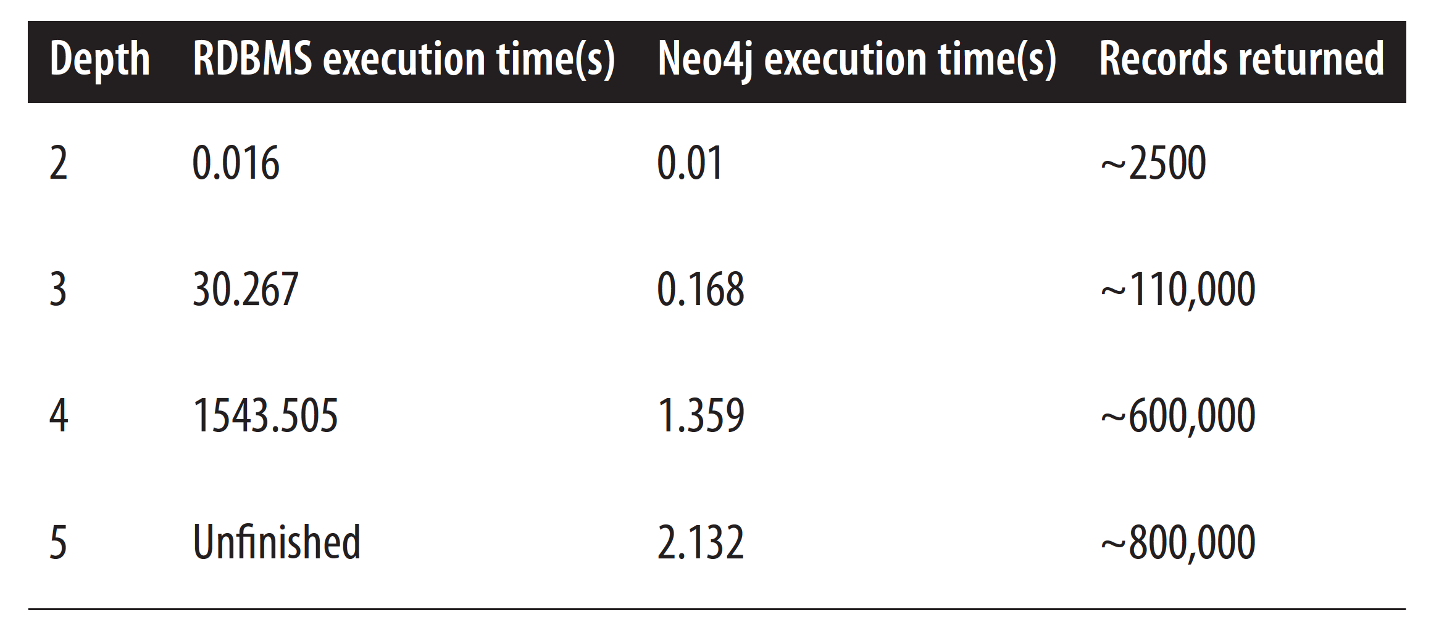
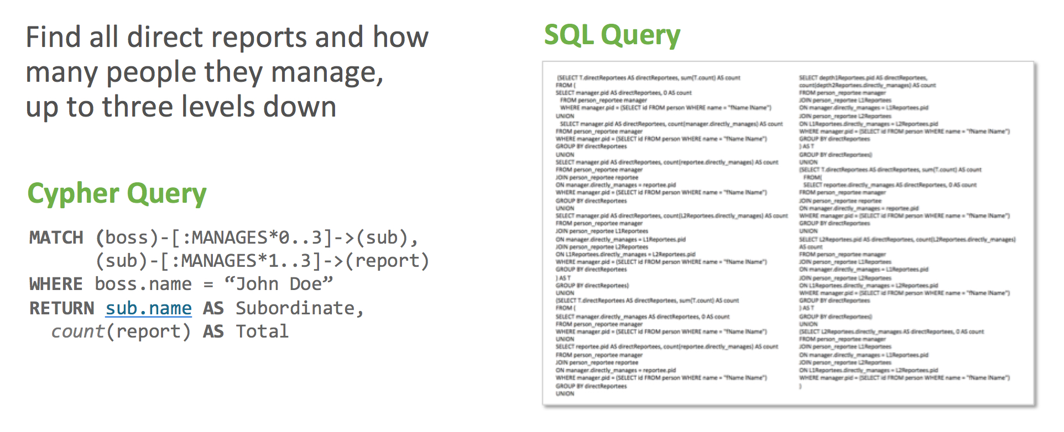
DATABASE SELECTION
Neo4j
Relationships
Expose schema visually
Efficient
SQL
Primary and foreign keys
No visualisation
Performance challenges
Notes:
The reason for using neo4j instead of SQL is because firstly neo4j uses relationships between nodes to retrieve data, so it doesn’t require us to link multiple tables together. For SQL, we usually store data into multiple tables, so there will be many tables joined together using the primary and foreign key to get the data. Secondly, neo4j expose the schema visually where you can see how the nodes are linked together, you can even expand the nodes to see multiple layers of relationships. Thirdly, neo4j is also much more efficient where we can see that the execution time for different depth is faster than SQL. The reason for this is because SQL runs up to performance challenges when it tries to navigate connected data. Finally, creating a query in neo4j is simpler as you can see that the 3 line query in cypher language is equivalent to the 2 paragraph of SQL query

Slide 26
DATABASE COMPARISON
Neo4j
Graph database
Cannot store JSON object
Can store documents’ metadata into a node and the URL pointing to the them
MongoDB
Document database
Can store documents/JSON object

Slide 27
Internship: 50 working days
PROJECT SCOPE
HR Policy Website
Presentation Preparation (5 days)
Users’ search history
Scrape data
Flask Framework
(5 days)
(15 days)
Insert data
Recommend
Retrieve data
(5 days)
Machine learning (User-Based Collaborative Filtering)
Machine Learning (Document Clustering)
(10 days)
(10 days)

Slide 28
FUTURE DEVELOPMENT
Deployability
Text summarization (for extracting important information of a policy)
Text correction/suggestion (when people misspelled stuff)

Slide 29
PRESENTATION DESIGN
This presentation uses the following typographies and colors:
Titles: Oswald
Body copy: Source Sans Pro
You can download the fonts on this page:
https://www.fontsquirrel.com/fonts/oswald
https://www.fontsquirrel.com/fonts/source-sans-pro
Sky blue #00cef6 / Bright green #aff000 / Blue #3c78d8 / Dark blue #28324a
You don’t need to keep this slide in your presentation. It’s only here to serve you as a design guide if you need to create new slides or download the fonts to edit the presentation in PowerPoint®

Slide 30
SlidesCarnival icons are editable shapes.
This means that you can:
Resize them without losing quality.
Change fill color and opacity.
Change line color, width and style.
Isn’t that nice? :)
Examples:

Slide 31
😉
Now you can use any emoji as an icon!
And of course it resizes without losing quality and you can change the color.
How? Follow Google instructions https://twitter.com/googledocs/status/730087240156643328
✋👆👉👍👤👦👧👨👩👪💃🏃💑❤😂😉😋😒😭👶😸🐟🍒🍔💣📌📖🔨🎃🎈🎨🏈🏰🌏🔌🔑 and many more...

